Slide 1

ARABIC SIGN LANGUAGE TRANSLATOR
Engineering Department
Computer Systems Engineering
Mohammad Saed Haj-Mahmoud
Shamel Abdullah Juidy
Moawyah Hammoudeh Abdulrahman
Supervisor: Dr. Thaer Sammar

Slide 2
Introduction

Slide 3
Sign language importance
Sign language is vital for deaf communication, enabling visual expression of thoughts and emotions, fostering inclusivity and accessibility in society.

Slide 4
Difficulties That Face Deaf People
Hearing disabilities pose communication barriers, isolation, limited information access.

Slide 5
Benefits of ARSL Translator
An Arabic Sign Language real-time translator revolutionizes communication for Arabic sign language users by instantly translating sign language gestures into written Arabic, enhancing accessibility and inclusivity.

Slide 6
Problem Statement
Difficulties in finding sign language interpreters.

Slide 7
Problem statement(continued)
Sign language varies globally, with unique vocabulary, grammar, and cultural aspects. Examples include ASL, BSL, and Auslan.

Slide 8
Problem statement(continued)
Around 7.5 million people in Egypt alone have hearing disabilities, who represent 10% of the total number of the deaf and mute in the whole world (according to the World Federation of the Deaf).

Slide 9
How the Solution Works

Slide 10
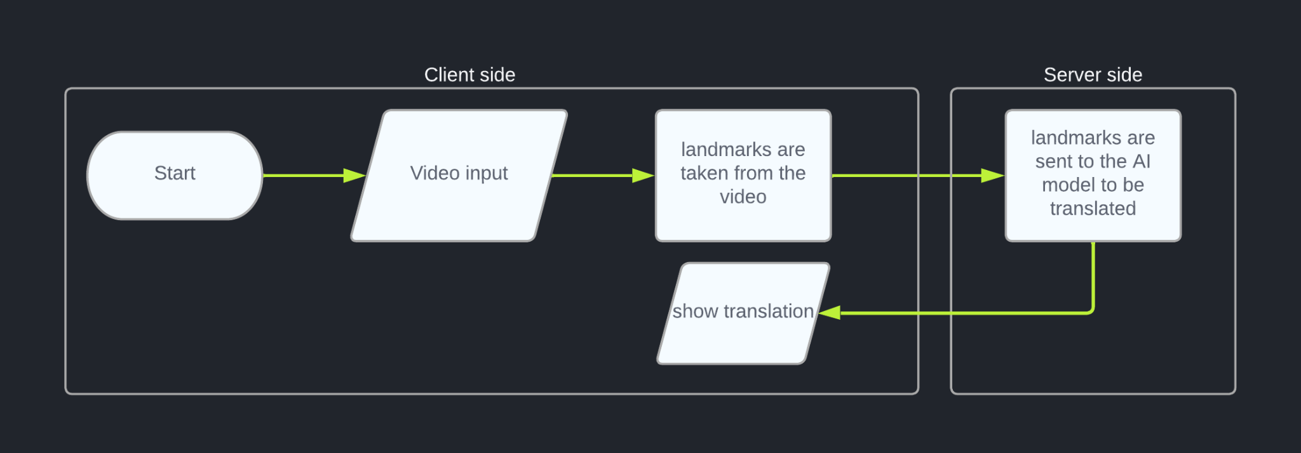
Translation Flow Diagram

Slide 11

Translation Demo

Slide 12
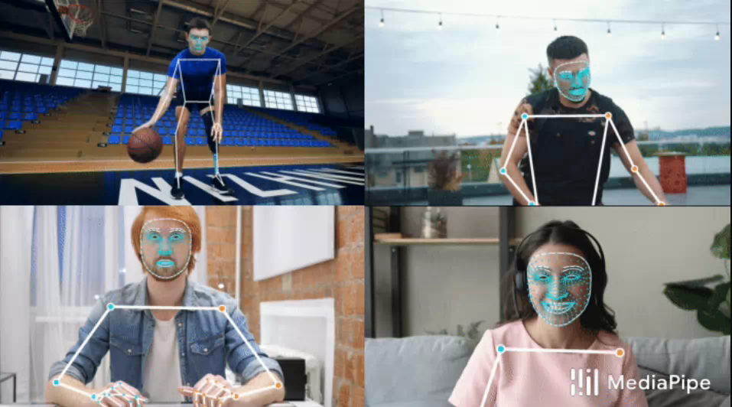
MediaPipe

Slide 13
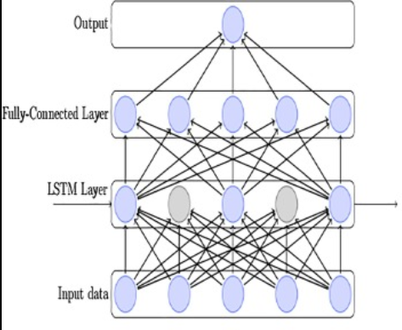
Neural Networks

Slide 14
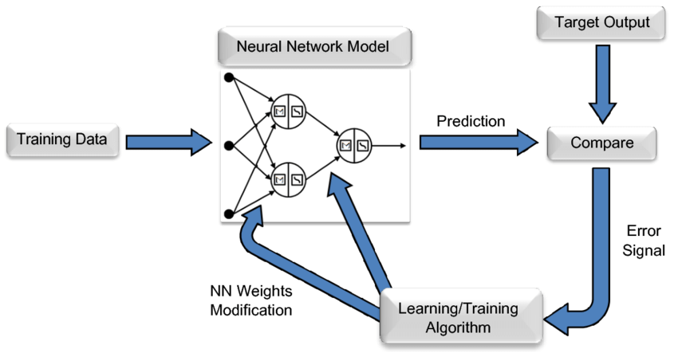
Model Training Process

Slide 15
Difficulties:
There is not much attention given to the disabled Arabs.
There is no available data for the ARSL.

Slide 16
Data Gathering
Notes:
Explain how we collected a comprehensive dataset of Arabic Sign Language.

Slide 17
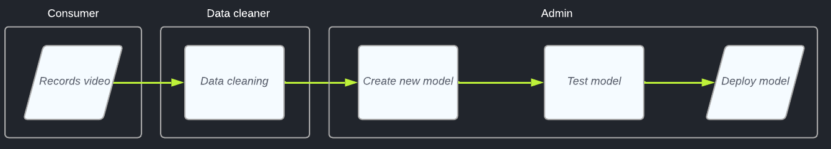
Data Gathering Flow Diagram:

Slide 18
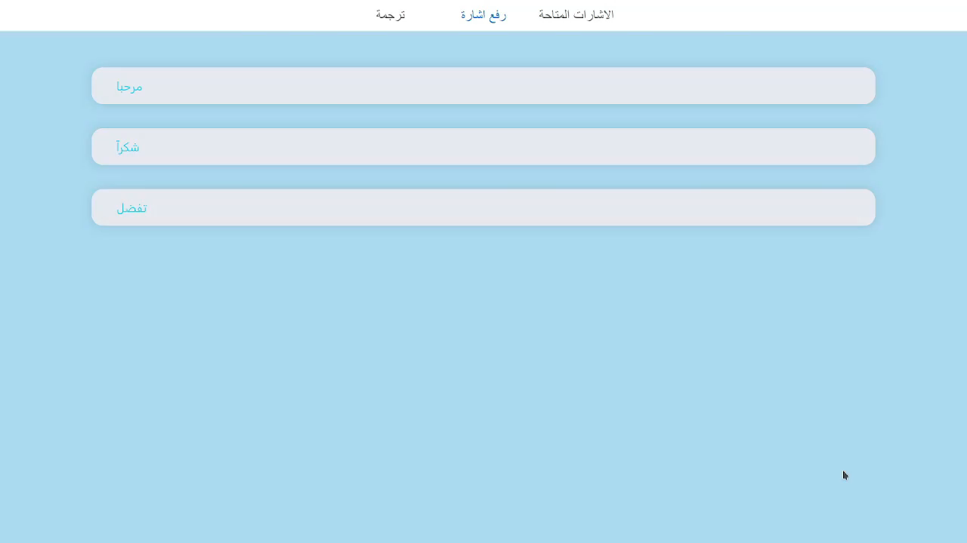
Upload a new video:

Slide 19
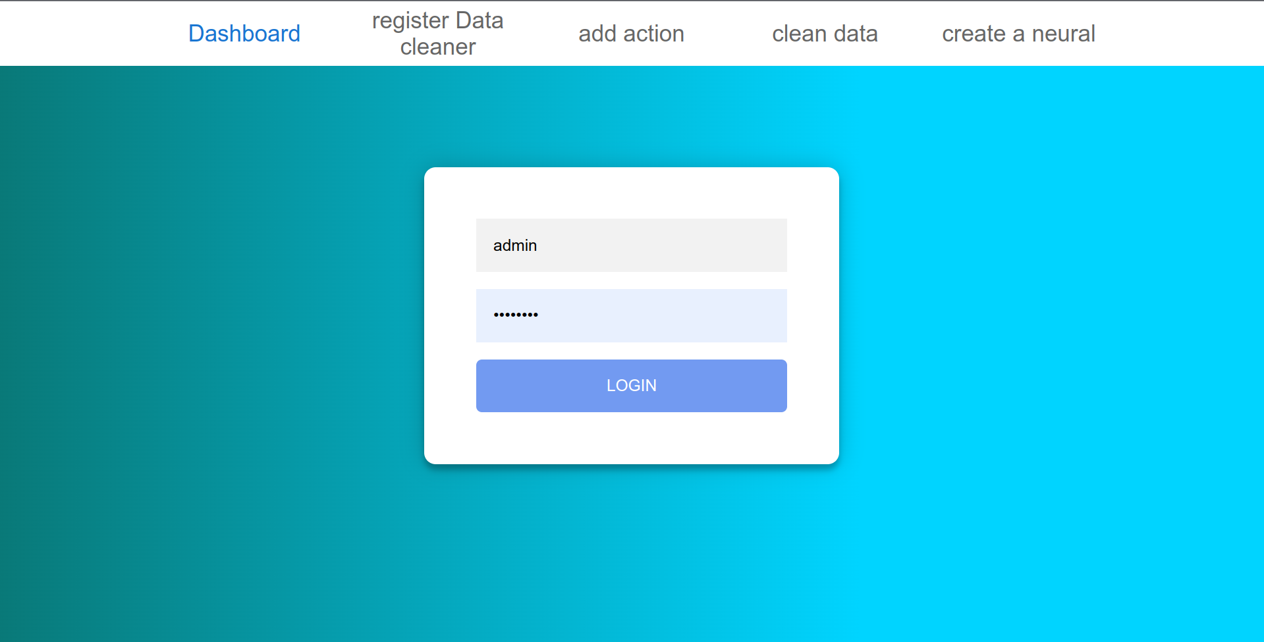
Admin login page:

Slide 20
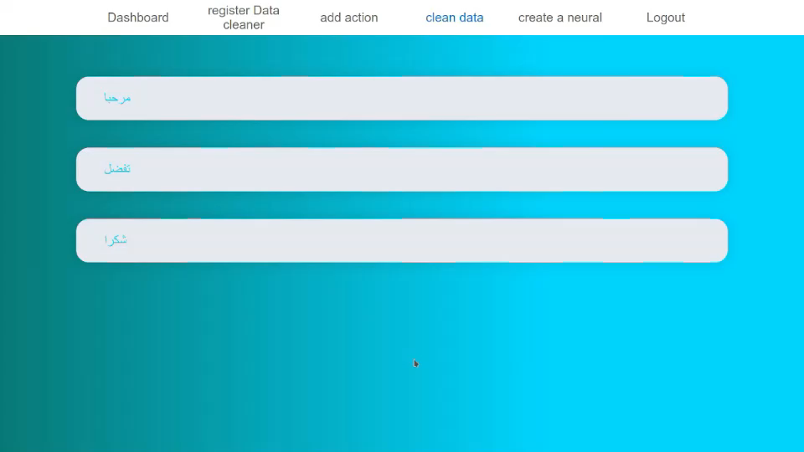
Clean Data:

Slide 21
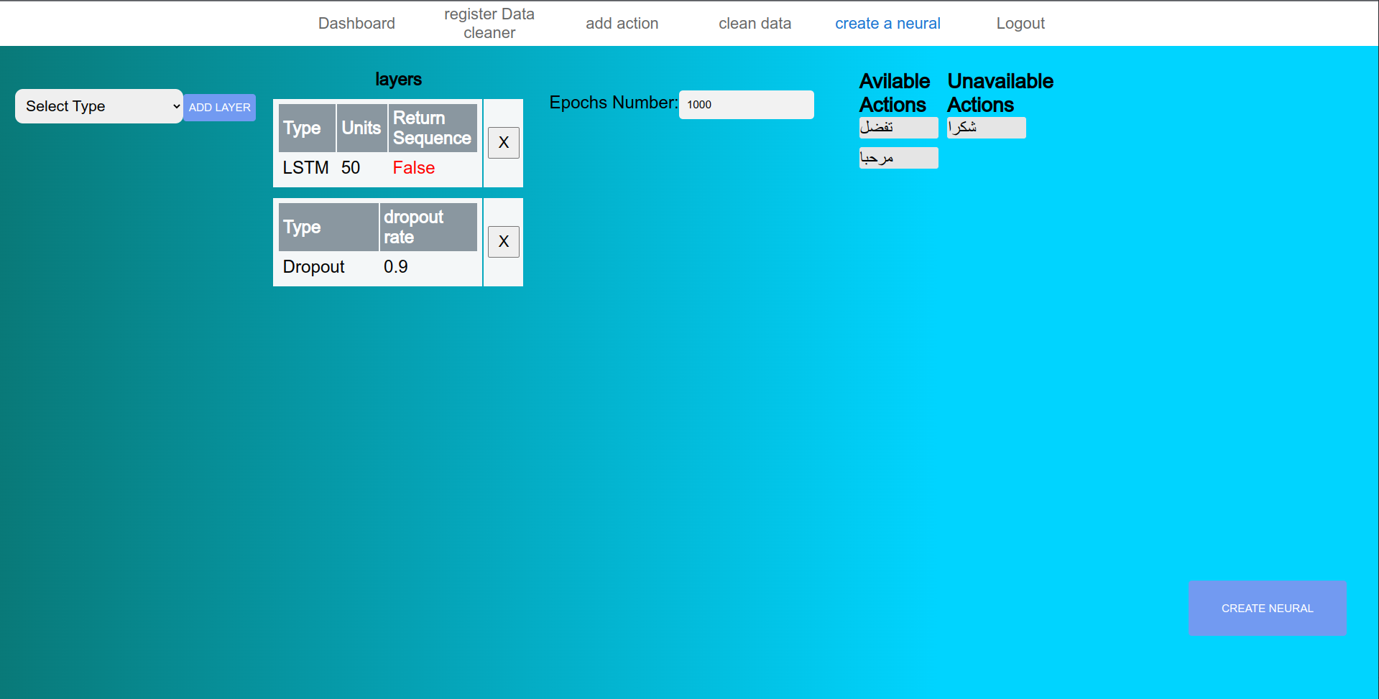
Create neural network:

Slide 22
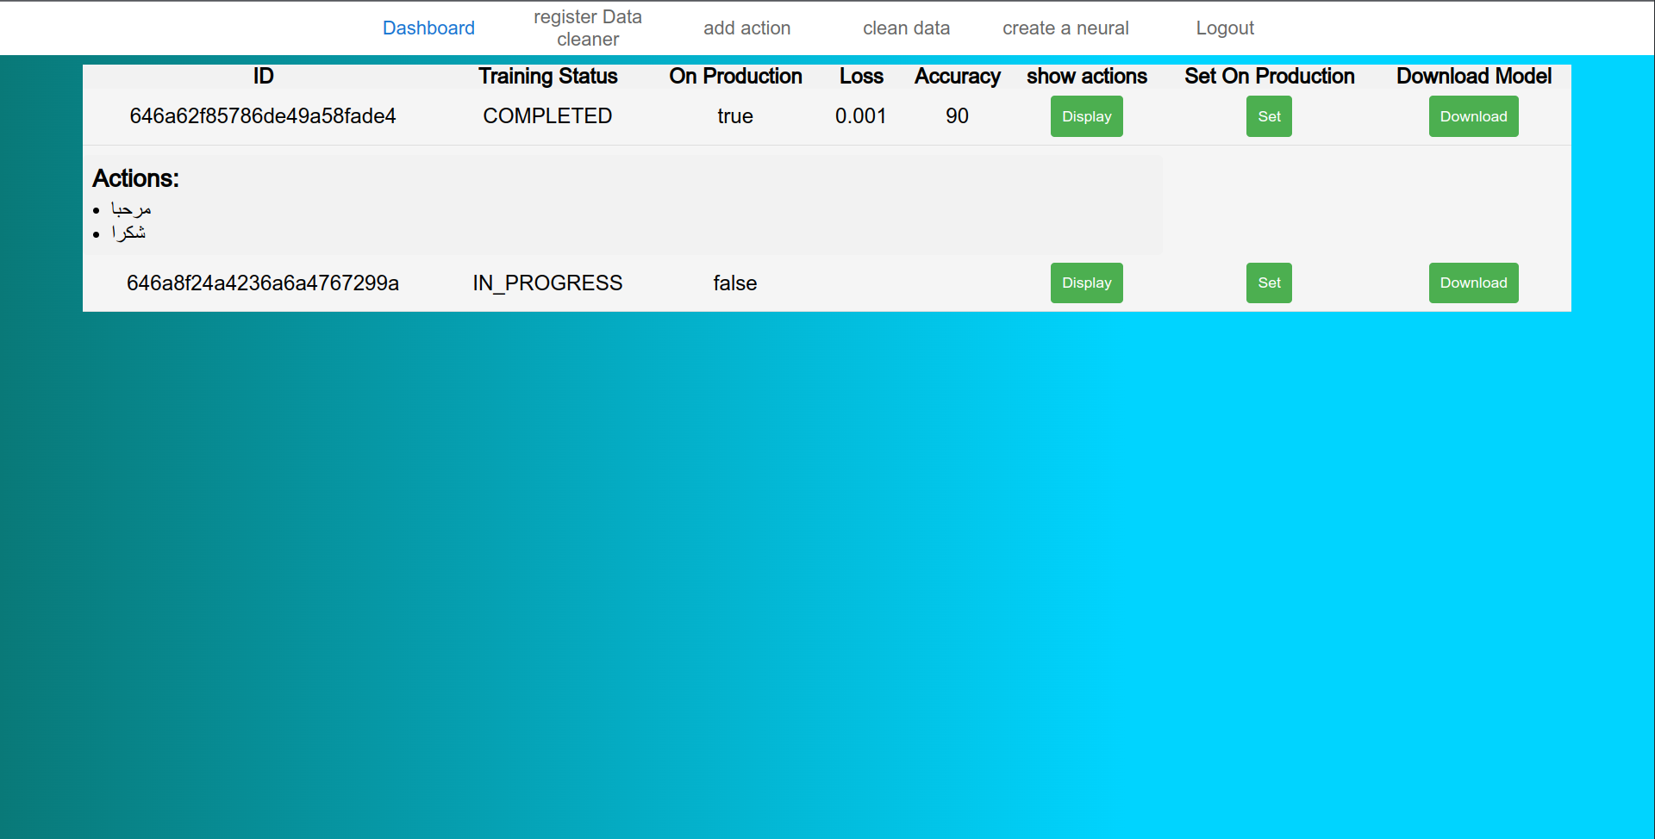
Admin Dashboard:

Slide 23
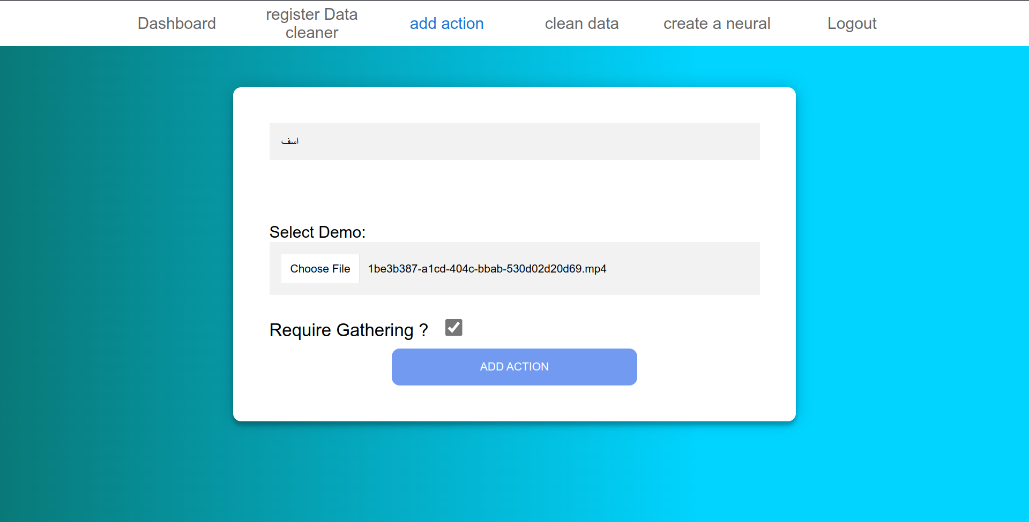
Add action:

Slide 24
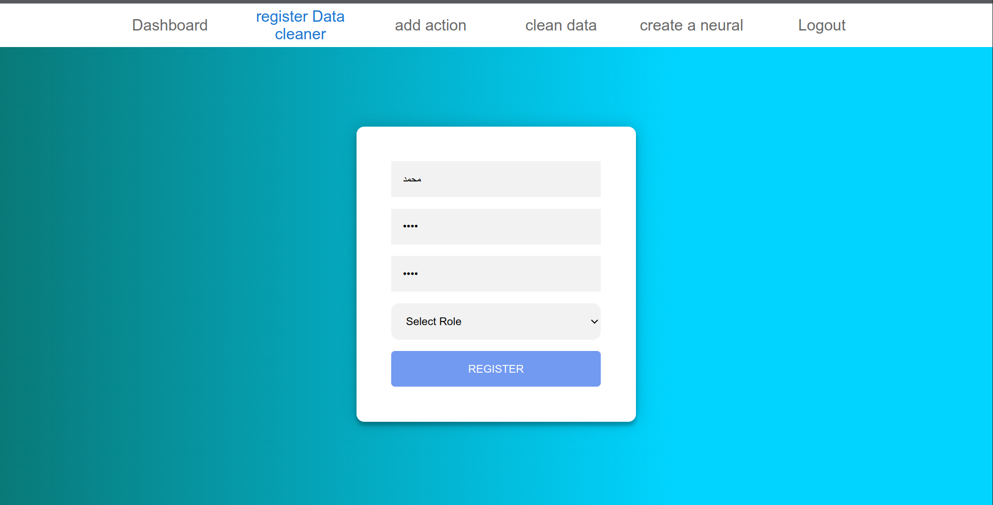
Register new user:

Slide 25
Future Plans:
Make it an integration for online meetings.
Make automation for cleaning.

Slide 26
THANK
YOU

